Slide 1
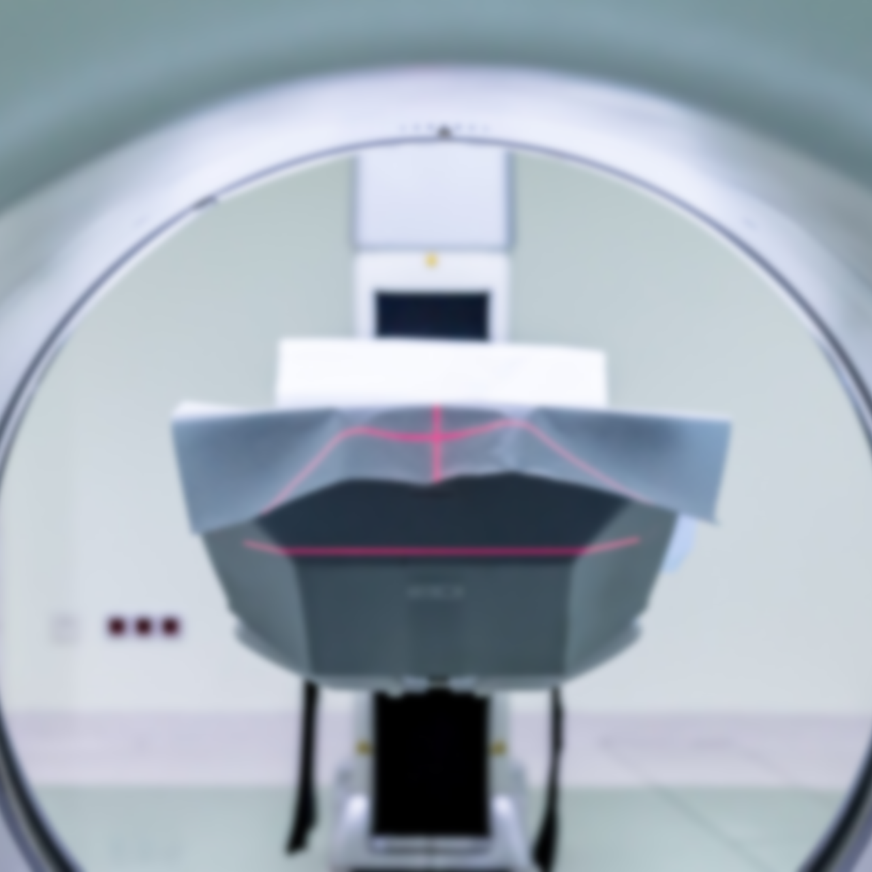
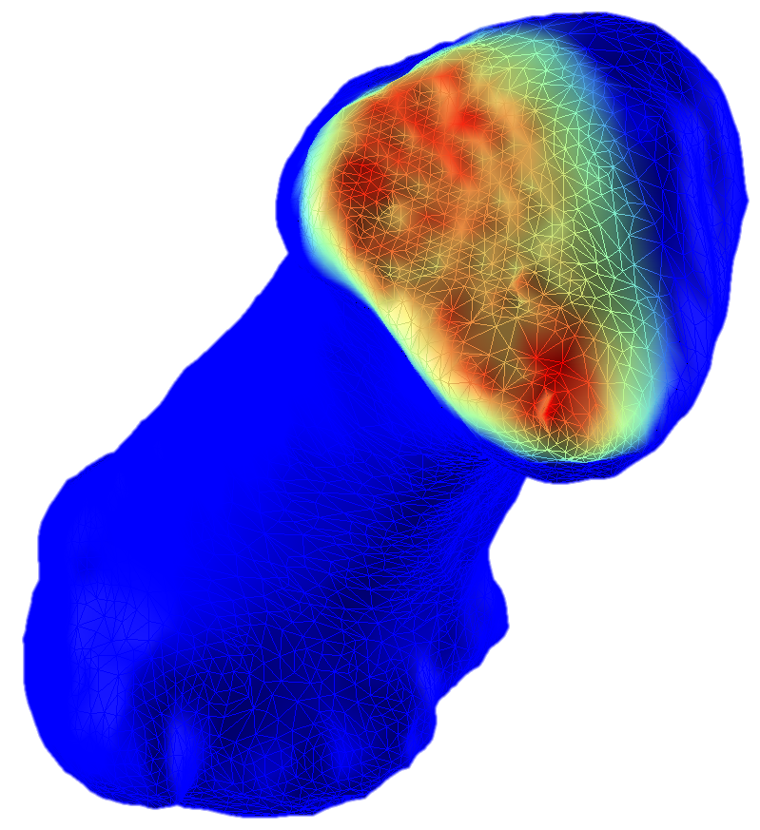
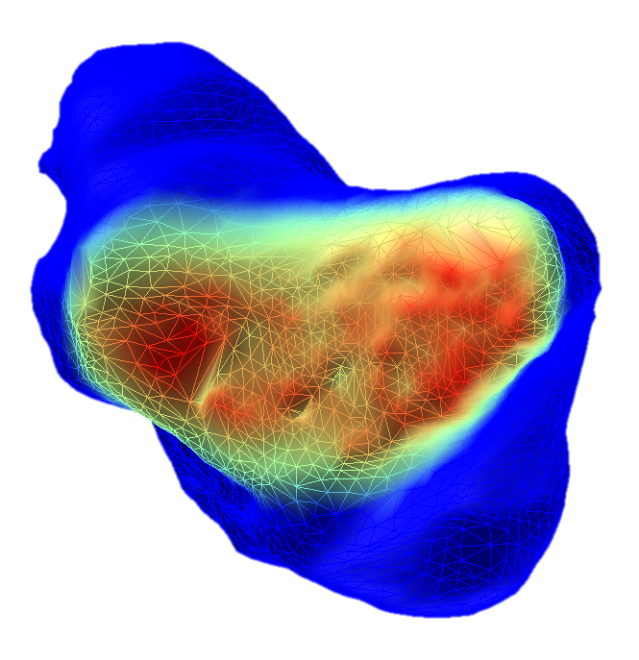
Evaluating Intra-Articular Joint Pressure Using Medical Imaging Technology

Slide 2
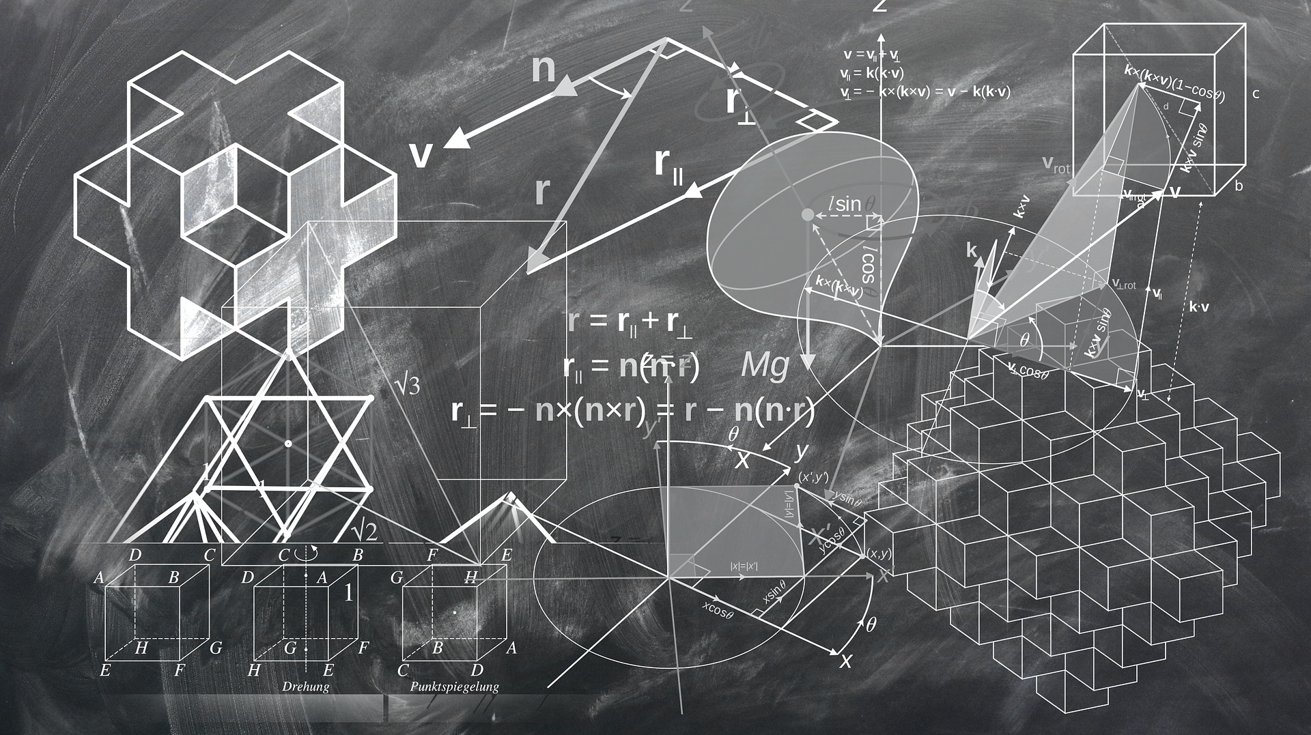

Development of a Series of Algorithms to Perform Transformations on 3D Objects

Slide 3
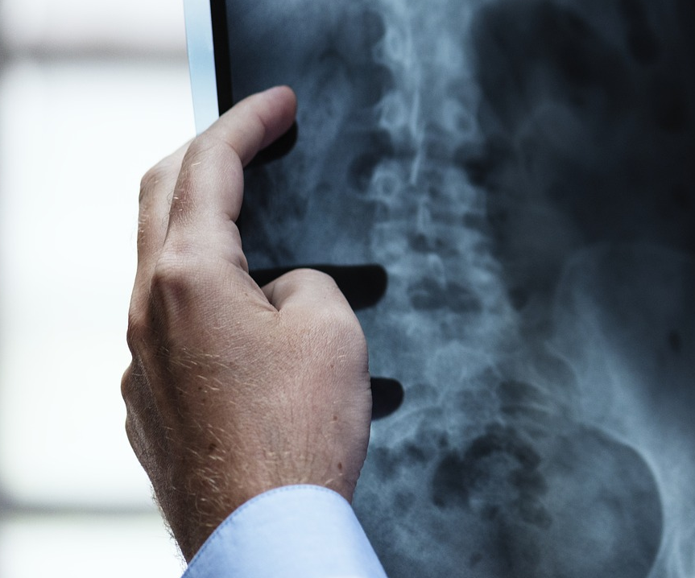
Assessing Human Joints Mobility Using Static Medical Imaging Technology

Slide 4
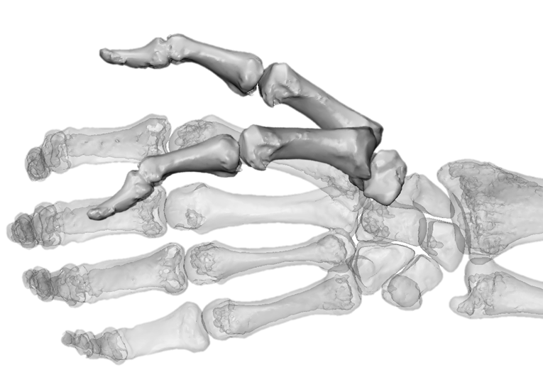
Measuring the Accuracy of Dynamic Medical Imaging to Assess Thumb Motion

Slide 5
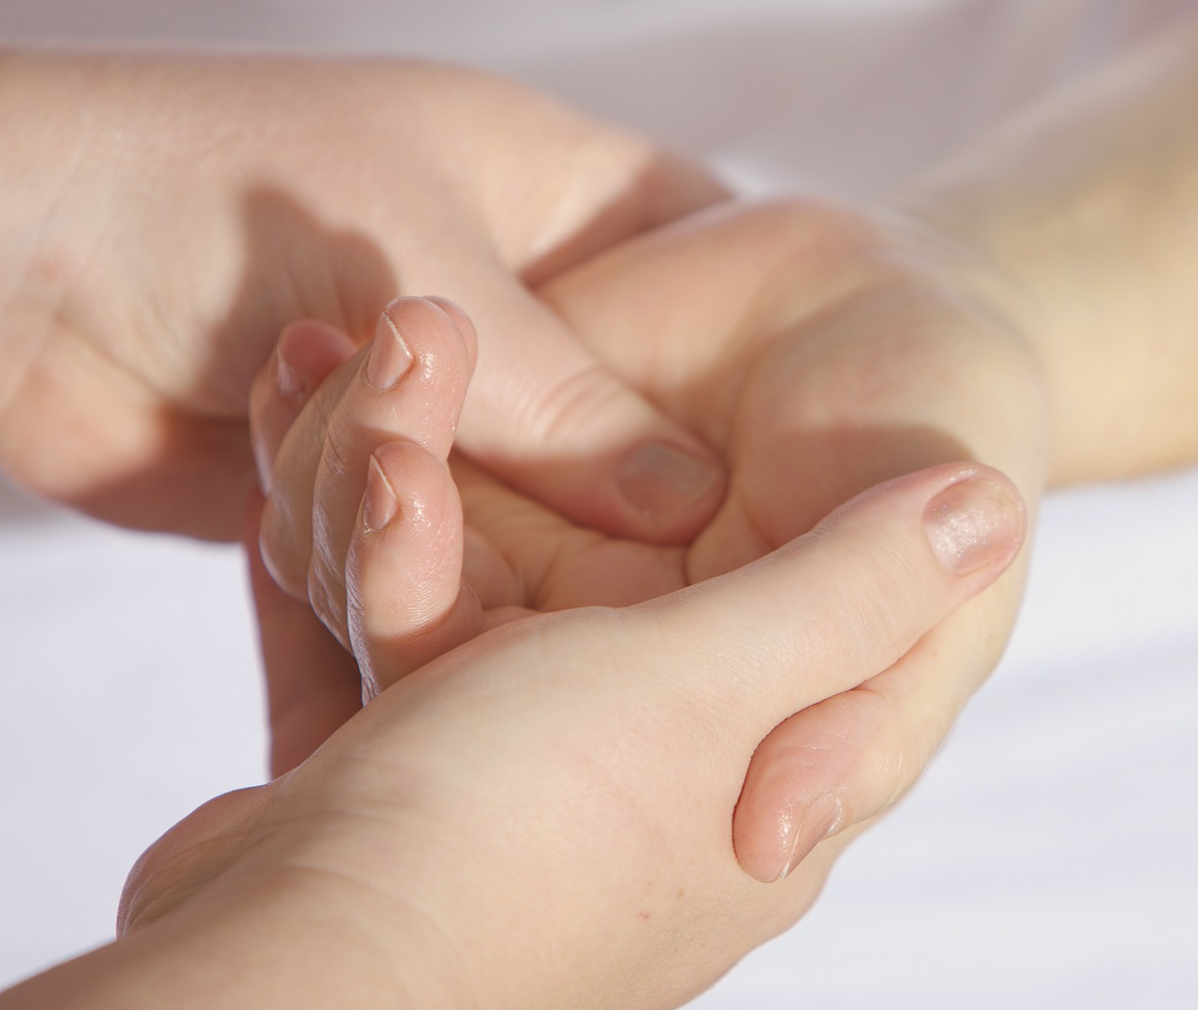
Assessing the Morphological Impact of Thumb Osteoarthritis

Slide 6
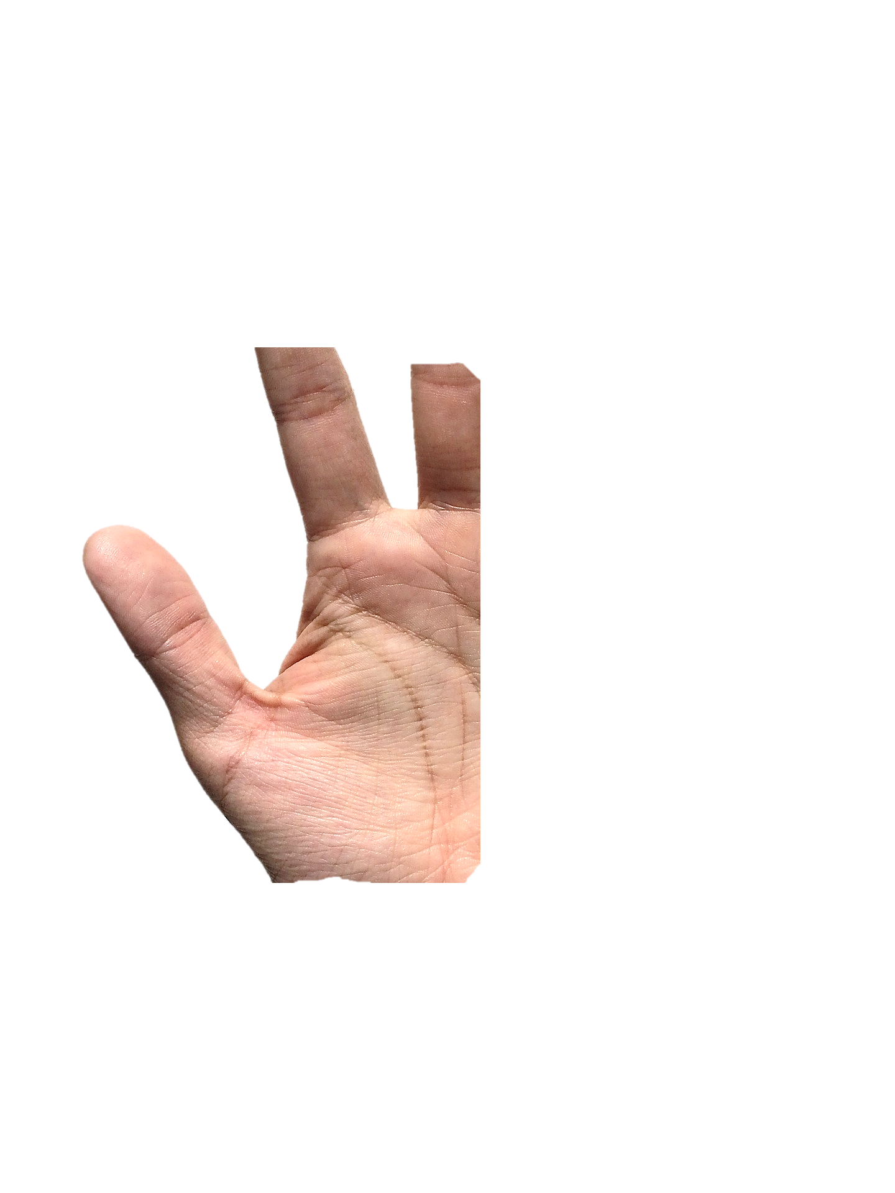
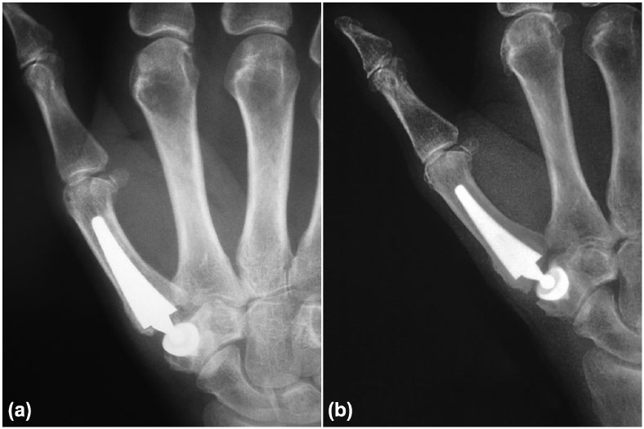
Measuring the Impact of Total Thumb Replacement on Hand Mobility

Slide 7

Development of a Series of Algorithms to Perform Signal Processing Operations

Slide 8
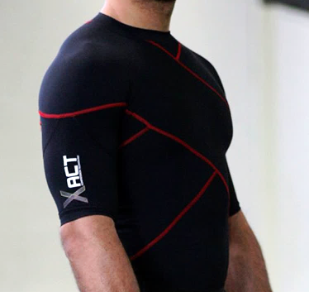
Measuring the Impact of Compression Garments on Shoulder Mobility and Stability

Slide 9

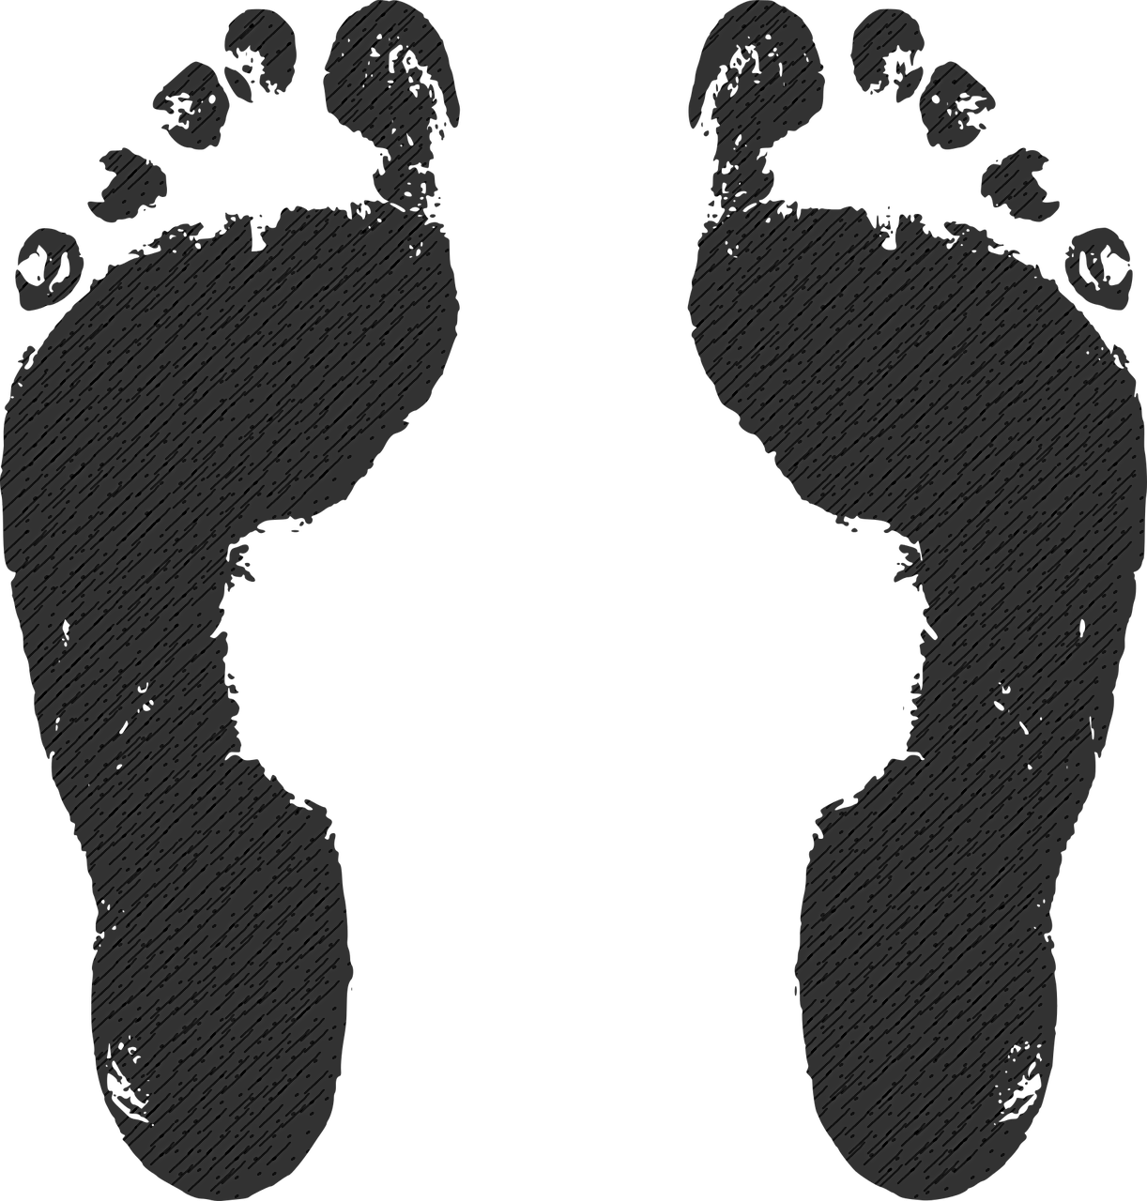
Comparison Between Foot Pressure Mapping Technologies

Slide 10
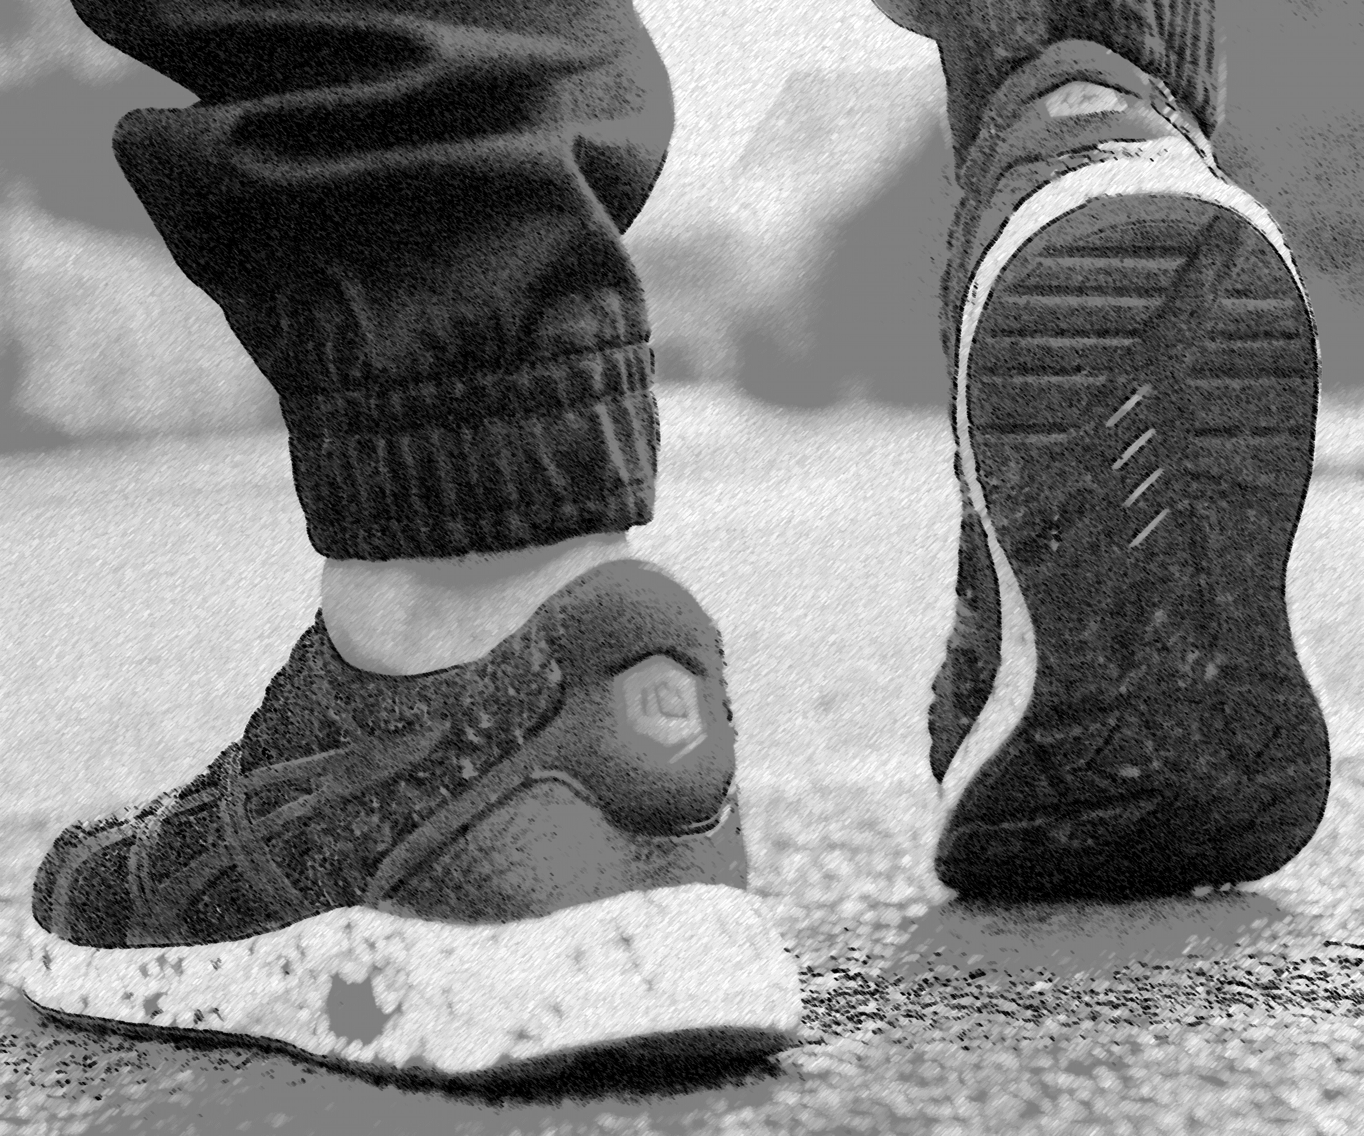
Measuring the Impact of Custom Orthotics on Legs and Feet Biomechanics

Slide 11

AI
Development of a Series of Machine Learning Algorithms to Solve Classification Problems

Slide 12
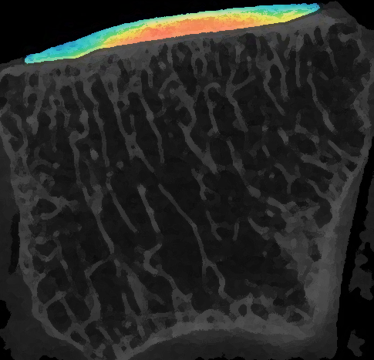
SOFT TISSUES PROPERTIES
Academic
Publication
Assessing Soft Tissues Properties Using Contrast Enhanced Medical Imaging Technology
Developed a protocol to assess soft tissues properties using medical imaging
2018

Slide 13
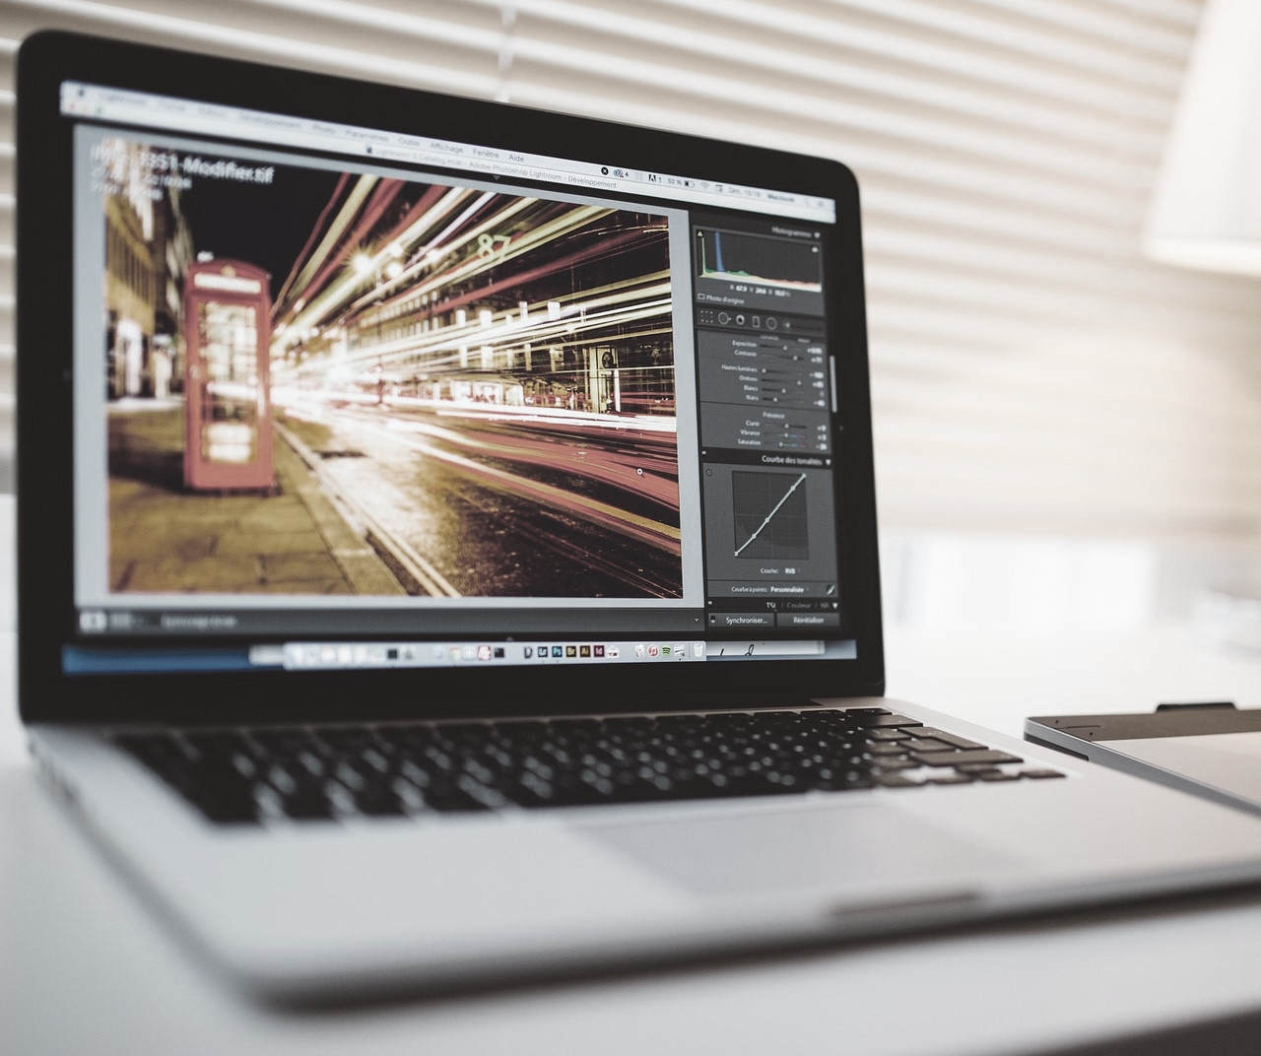
Development of an Image Annotation Tool for Algorithm Performance Assessment

